Slide 1
Local timesheet guideline
Author: Nguyen Thanh Cong (MS/EDA22-XC)

Slide 2
LOCAL TIMESHEET
1. GOAL
This application will support record all daily activities of all associates in detail
Manager will collect all data to create project bill for customer
Manager will follow your data and they can know What did you do

Slide 3
LOCAL TIMESHEET
2. HISTORY
Date | Author | Description
April 25th, 2022 | Nguyen Thanh Cong | The first release of guideline Release the LocalTimesheet R2.1.0, detail in here: VIDEOTEST-52
April 29th, 2022 | Nguyen Thanh Cong | Release the LocalTimesheet R2.1.1 Add some new feature, detail in here: VIDEOTEST-335
June 8th, 2022 | Nguyen Thanh Cong | Release the LocalTimesheet R2.1.2 Add some new feature, detail in here: VIDEOTEST-400

Slide 4
LOCAL TIMESHEET
3. ACTIVITY LIST
2.1. INTRODUCTION
Activity | Level | Usecases
Executing_Task | TASK | Performing daily task, task ID is available (CSCRM, T&R)
Reviewing_Task | TASK | Reviewing an executing task of another associate, task ID is available (CSCRM, T&R)
Task_Coordination | TASK | Supporting another associate for their task
Project_Coordination | PROJECT | Stand-up meeting, team meeting, project meeting (PCMe, TPMe,…)
Project_Competency | PROJECT | Tooling, sharing, build personal competency
Project_Training | PROJECT | Trainer, trainee of specific topic
Organizational_Activities | ORGANIZATION | Organization event, department meeting, group meeting, team activity (e.g: Birthday,…)
Leave | PERSONAL | Full-day leave, Half-day leave
Holiday | ORGANIZATION | Traditional holiday
Expected mandatory working time

Slide 5
LOCAL TIMESHEET
3. ACTIVITY LIST
2.2. MANDATORY FIELDS
Activity | Project Name | Task ID | Duration | Comment
Executing_Task
Reviewing_Task
Task_Coordination
Project_Coordination
Project_Competency
Project_Training
Organizational_Activities
Leave
Holiday
Expected mandatory working time
Mandatory fields should be full-filled

Slide 6
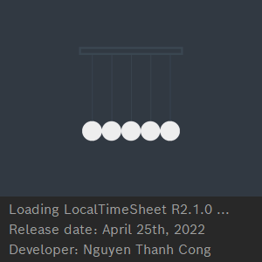
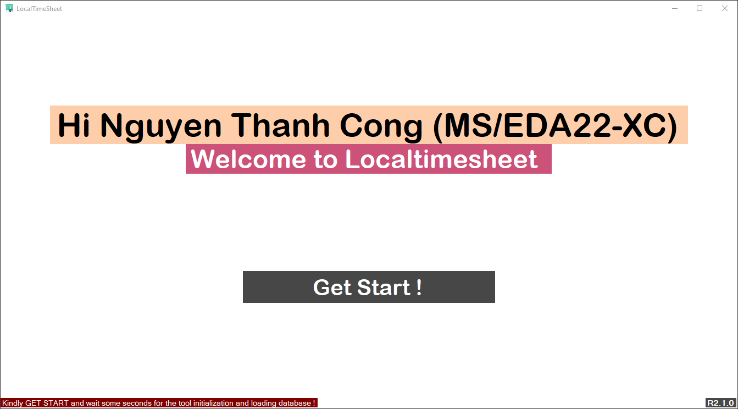
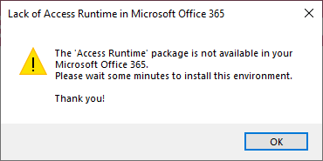
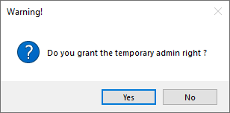
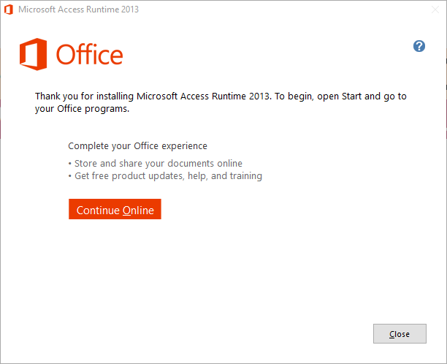
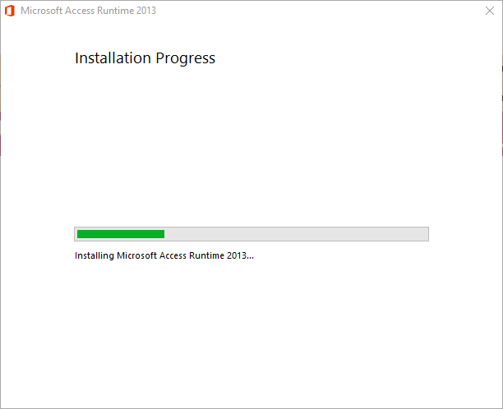
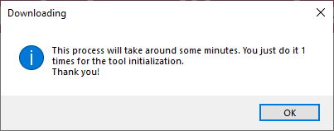
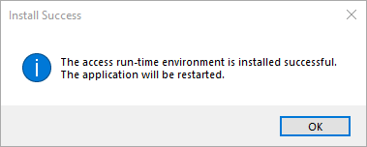
LOCAL TIMESHEET
4. OPEN APPLICATION PROCESS
4.1. CASE 1 – YOU ARE USING OFFICE 365
Run the exe and wait to access to homepage
Click Get Start
INSTALL COMPLETED
Waiting in around 1 minute tinstall the access runtime 2013 package
Note*: Temporary Admin Right should be granted via ISM before these steps
READ ME
Click OK the restart the application
1 - You just install this package only 1 time in your system
2 - After install the Access runtime successfully, the OPEN process will be same with the case 2 (detail in the next slide)
3 - This LocalTimesheet use MS Access database to store all data, but MS office 365 doesn’t support the provider for MS Access fully, so we need to install the Access Runtime Package to activate the MS Access provider

Slide 7
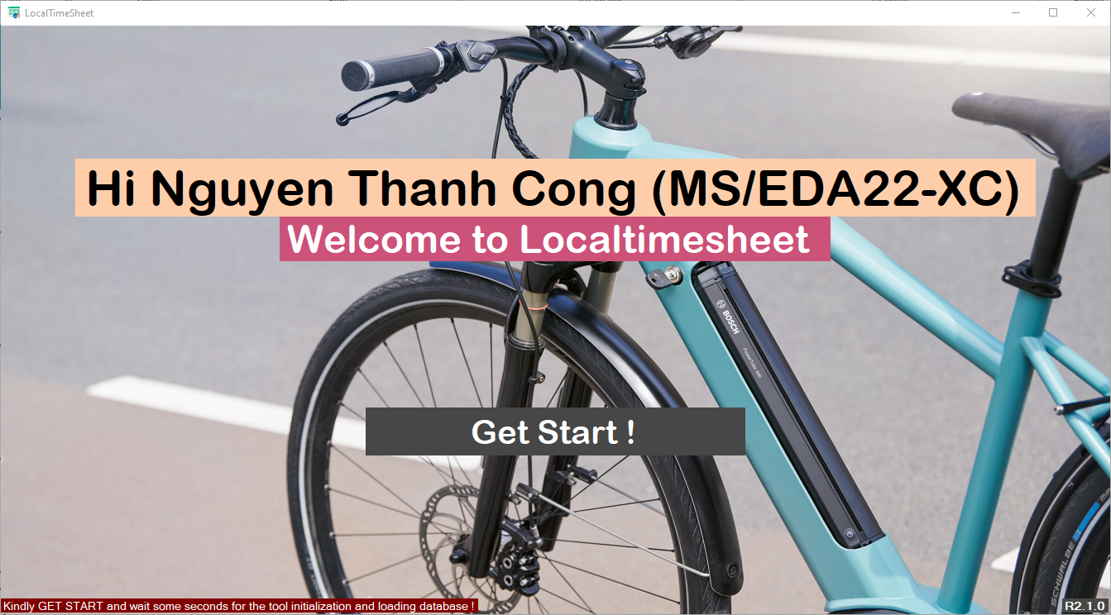
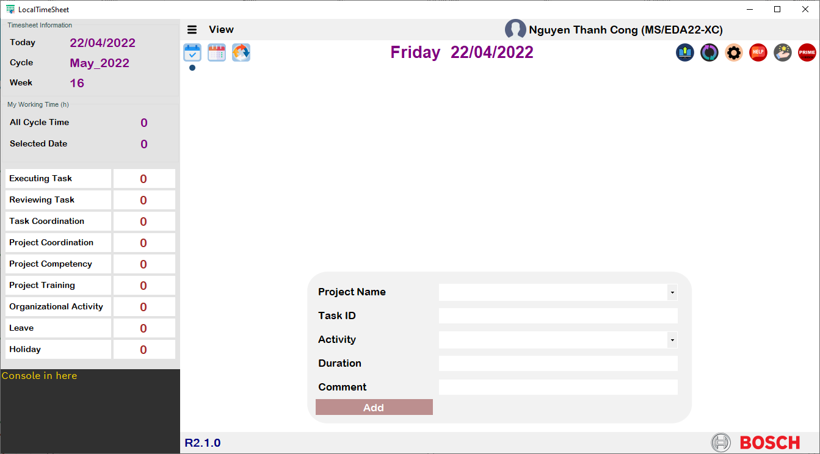
LOCAL TIMESHEET
4. OPEN APPLICATION PROCESS
4.2. CASE 2 – YOU AREN’T USING OFFICE 365
Wait some time to config and load the application
Run the exe and wait to access to homepage
Click Get Start!
Main Page
Note*: If you work from home, the wait time in this step is longer than in office, because of network reason
(VPN at home will be slower than directly WiFi at office)

Slide 8
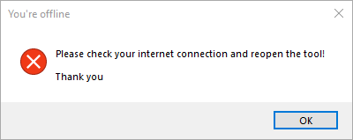
LOCAL TIMESHEET
4. OPEN APPLICATION PROCESS
4.3. CASE 3 – YOU ARE IN OFFLINE NETWORK
You can’t access to application because you’re offline
READ ME
This tool should be in Online to load the database from server, so you have to make-sure your network connection before access to this application

Slide 9
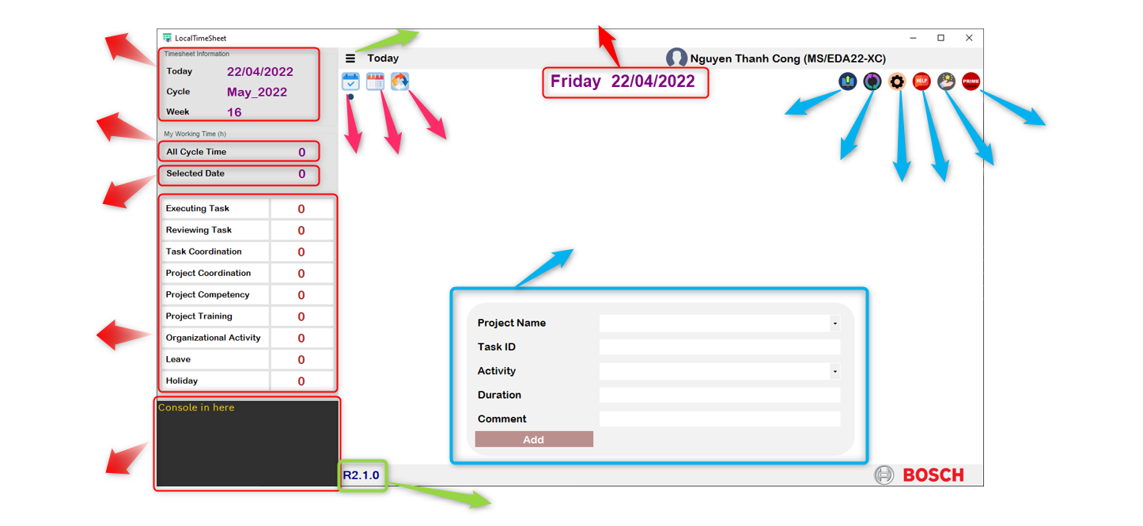
LOCAL TIMESHEET
5. FRONT-END OVERVIEW
5.1. OVERVIEW
Timesheet Information
Collapse/Expand the left Bar button
Show selected date
Show total working time of the selected cycle
SUBMIT
CYCLE view
PRIME
TODAY view
DAY view
DATA SYNCHRONIZATION
Show total working time of the selected date
FEEDBACK
SETTING
HELP
User input all activity data to this form
Detail working time of each activity of the selected cycle
All issue/ warning/ status are showed in here
Tool Release

Slide 10
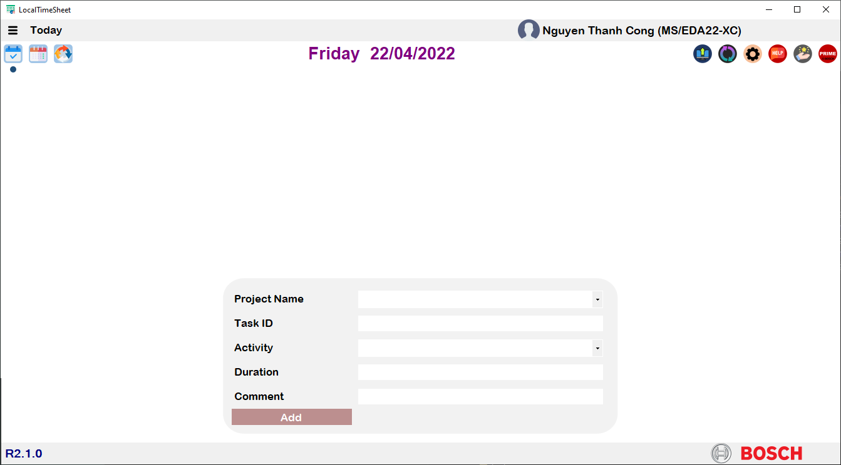
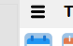


LOCAL TIMESHEET
5. FRONT-END OVERVIEW
5.2. COLLAPSE/EXPAND BUTTON
COLLAPSE THE LEFT BAR
EXPAND THE LEFT BAR

Slide 11
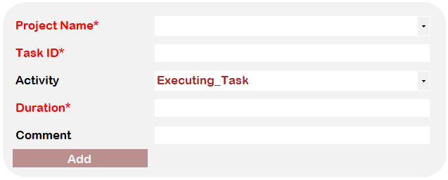
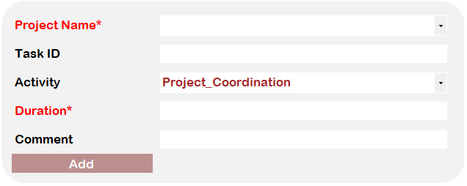
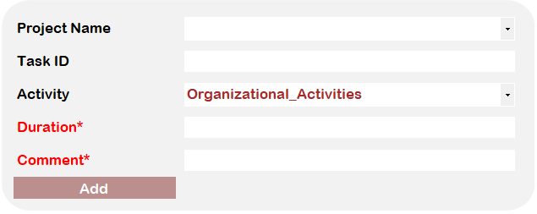

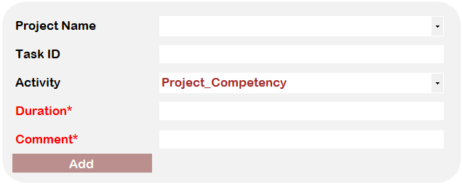
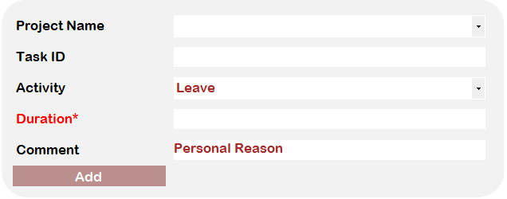
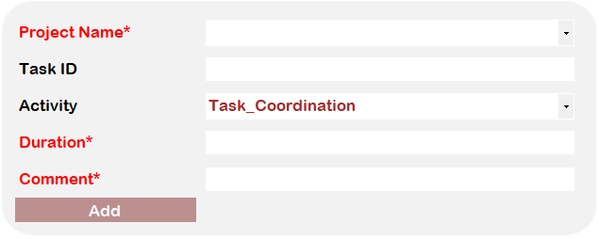
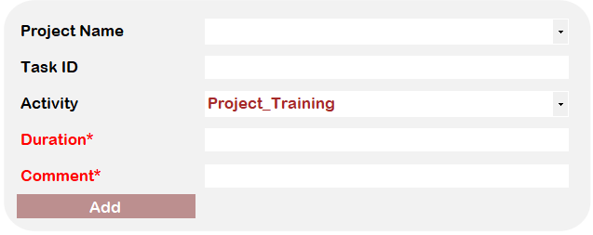
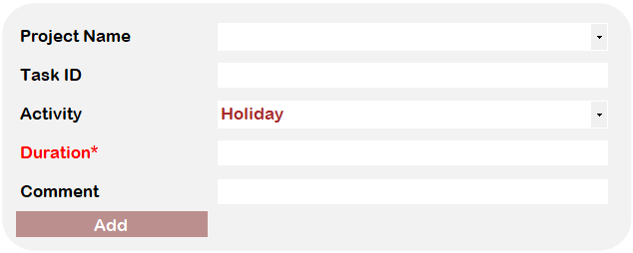
LOCAL TIMESHEET
6. INPUT DATA
6.1. MANDATORY FIELDS IN INPUT FORM

Slide 12

LOCAL TIMESHEET
6. INPUT DATA
6.2. DATA IS SYNCHRONIZED IN ALL VIEW
DATABASE
The same location
UI
Update new data together
Get Data
Update new data together
TODAY
VIEW
DAY
VIEW
CYCLE
VIEW
Update new data together

Slide 13
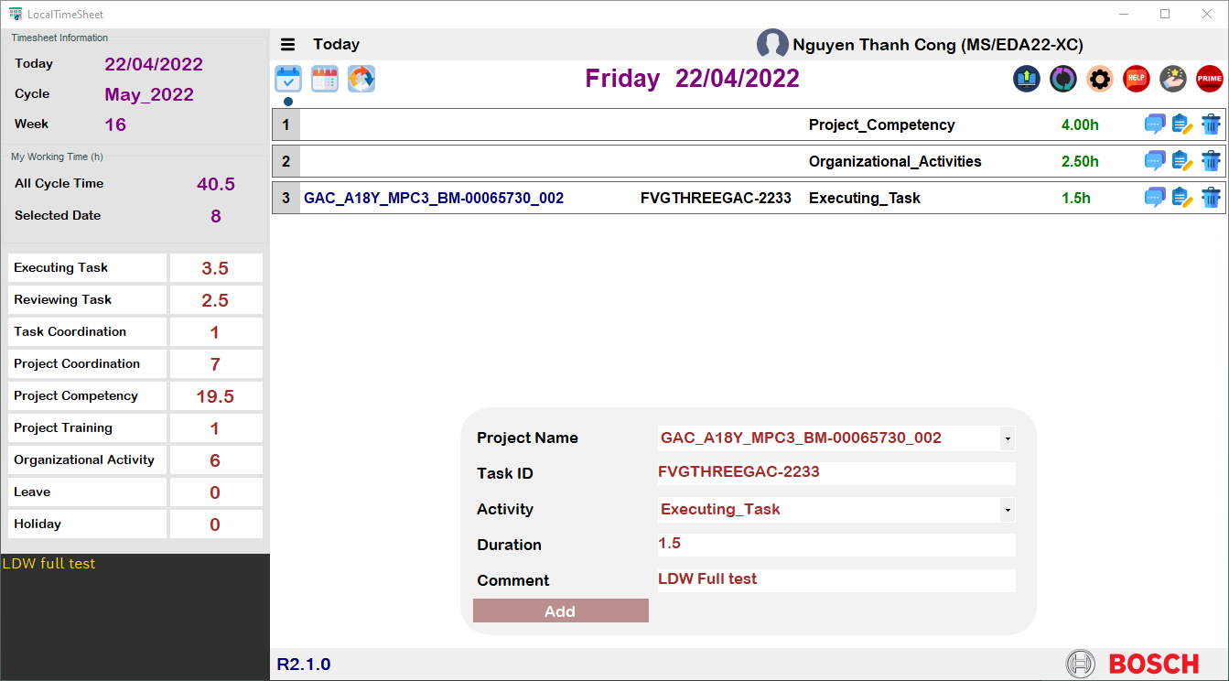
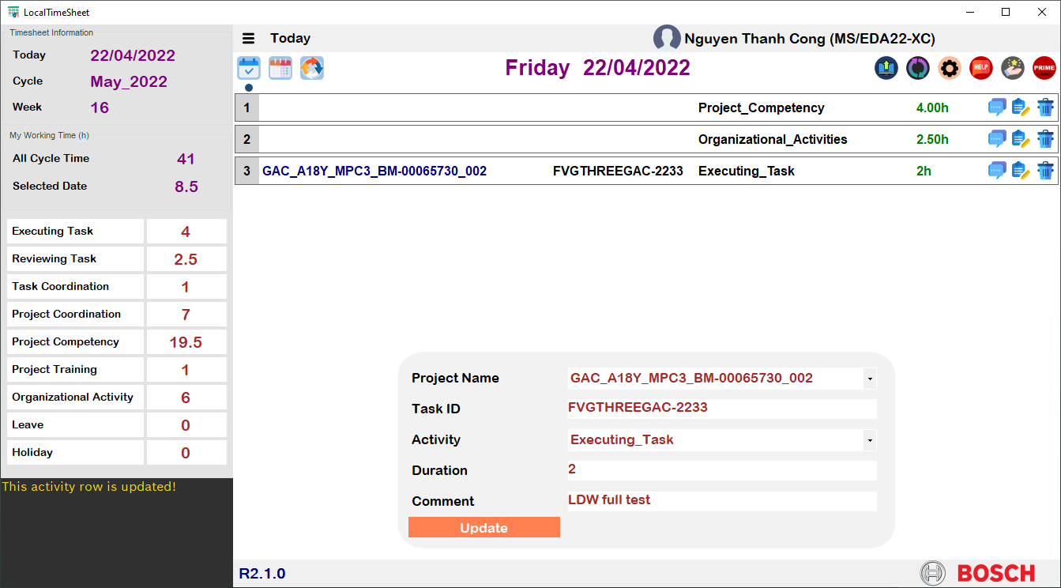
LOCAL TIMESHEET
6. INPUT DATA
6.3. TODAY VIEW
6.3.1. HOW TO INPUT DATA?
SUM = 8 hours
SUM = 8.5 hours
READ ME
GOAL OF TODAY VIEW
Show all data of the current date
User can input all activity of current date directly on the TODAY view

Slide 14
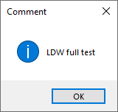

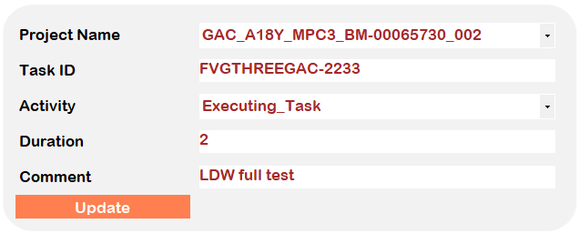


LOCAL TIMESHEET
6. INPUT DATA
6.3. TODAY VIEW
6.3.2. HOW TO HANDLE DATA?
Show the comment of the selected activity
COMMENT
Load the data line to the input form, after mofidying data, user click Update
EDIT
The data line is deleted immediately
DELETE
THE DATA LINE IS DELETED

Slide 15
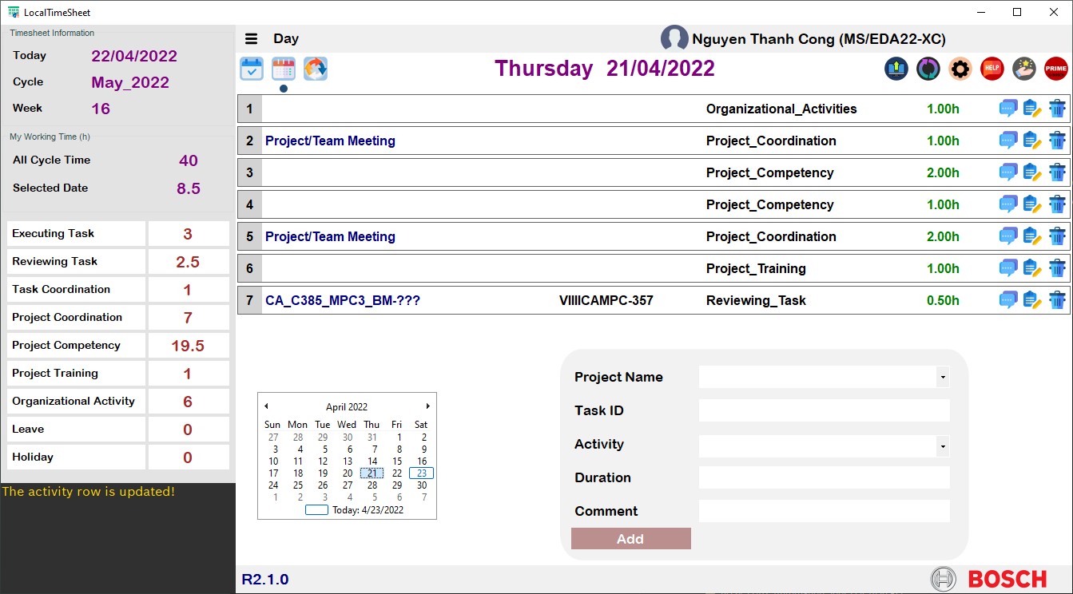
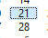
LOCAL TIMESHEET
5. INPUT DATA
6.4. DAY VIEW
6.4.1. HOW TO INPUT DATA?
THE SAME WITH TODAY VIEW
SELECT AND INPUT FOR ANY DATE FOR ANY CYCLE
READ ME
GOAL OF DAY VIEW
You can select another date and input data for this selected date
In some case, we have to focast our activity and submit the localtimesheet before the last date of cycle, so DAY view will be suitable for that case

Slide 16
LOCAL TIMESHEET
5. INPUT DATA
6.4. DAY VIEW
6.4.2. HOW TO HANDLE DATA?
THE SAME WITH TODAY VIEW
Show the comment of the selected activity
Load the data line to the input form, after mofidying data, user click Update
The data line is deleted immediately
THE DATA LINE IS DELETED

Slide 17
LOCAL TIMESHEET
5. INPUT DATA
6.5. CYCLE VIEW
6.5.1. STATUS COLOR
Color | Description
1 | This color show the weekend (Saturday, Sunday)
2 | This color and color 3 will split each day separately and clearly
3 | This color and color 2 will split each day separately and clearly
4 | No data in the day which’s in current or previous cycle
5 | Warning for mandatory fields should be filled of each activity
6 | This color will be displayed if user save the cycle view, but data is incorrect (e.g: incorrect project name, duration isn’t a number,…)

Slide 18
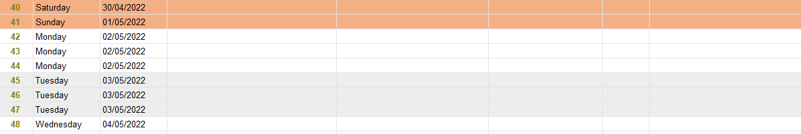
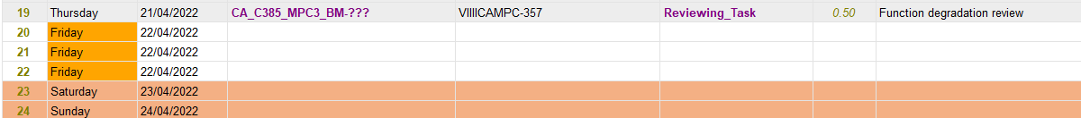
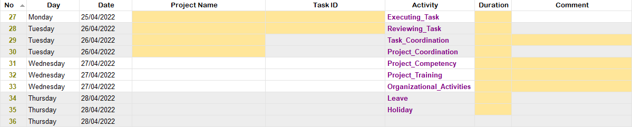
LOCAL TIMESHEET
5. INPUT DATA
6.5. CYCLE VIEW
6.5.1. STATUS COLOR
1
3
2
4
Because the date 22/04 is within from the first date of cycle May_2022 (16/04) to the current date (23/04)
5
Mandatory fields should be full-filled
Duration = “A” => Not a number
Project name is empty
6

Slide 19
LOCAL TIMESHEET
5. INPUT DATA
6.5. CYCLE VIEW
6.5.2. FEATURE & SHORT-CUT
OVERVIEW
NO | Feature | Shortcut | Description
1 | Cut | Ctrl+X | Cut the selected data to another position
2 | Copy | Ctrl+C | Copy the selected data to another position
3 | Paste | Ctrl+V | Paste the selected data from clip board to the selected position
4 | Delete | Del | Delete the selected data
5 | Insert before | Ins | Insert one row above the selected row with the same day and date
6 | Insert after | Ctrl+Ins | Insert one new row below the selected row with the same day and date
7 | Insert the next day | Ctrl+Shift+Ins | Insert one new row below the selected row with the next day and date of the selected row
8 | Add rows | Ctrl+Alt+Ins | Add the new empty row without day and date after the selected row
9 | Save | Ctrl+S | Save all data of the selected cycle
10 | Switch cycle | Not available | Select another cycle to load all data of this cycle
11 | Show working time | Not available | Show all respective working time information of selected date

Slide 20
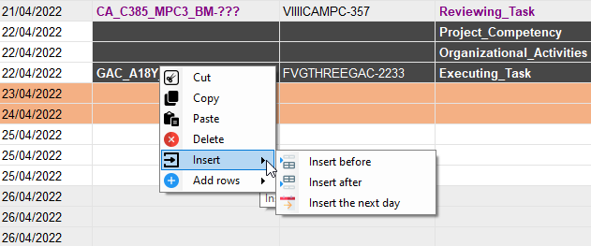
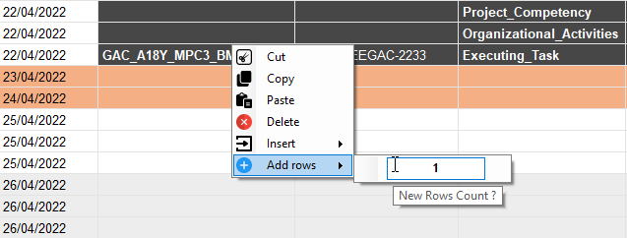
LOCAL TIMESHEET
5. INPUT DATA
6.5. CYCLE VIEW
6.5.2. FEATURE & SHORT-CUT
DETAIL
From feature 1 to 8 (ToolStripMenu), you can select data and right click, ToolStripMenu will be displayed
SELECT
RIGHT CLICK
TOOL STRIP MENU

Slide 21
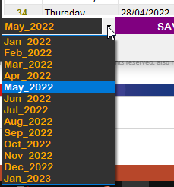
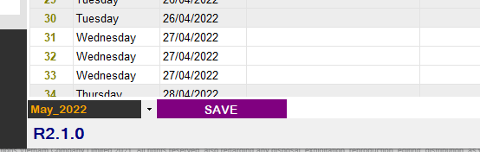
LOCAL TIMESHEET
5. INPUT DATA
6.5. CYCLE VIEW
6.5.2. FEATURE & SHORT-CUT
DETAIL
About feature 9 (SAVE), you can find the SAVE button in the bottom or Ctrl+S to save all data in selected cycle
About feature 10 (SWITCH CYCLE), you can open the cycle list and switch to the selected cycle
SELECTED CYCLE
SAVE BUTTON

Slide 22
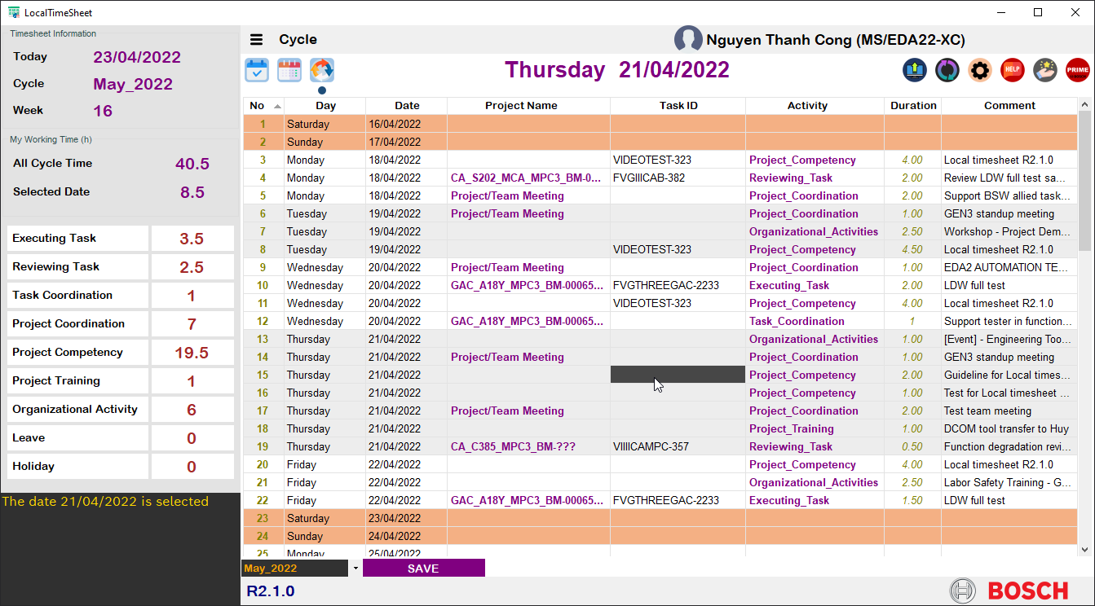
LOCAL TIMESHEET
5. INPUT DATA
6.5. CYCLE VIEW
6.5.2. FEATURE & SHORT-CUT
DETAIL
About feature 11 (SHOW WORKING TIME), You can select any row and all working time information of the selected date will be showed
Select any cell in the selected date row

Slide 23
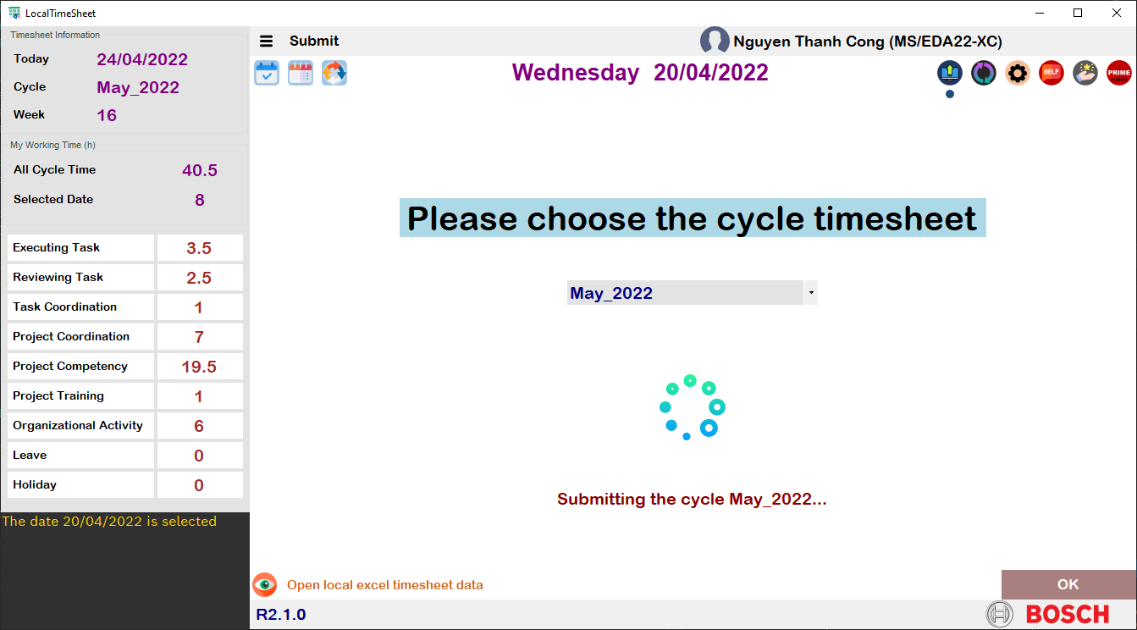
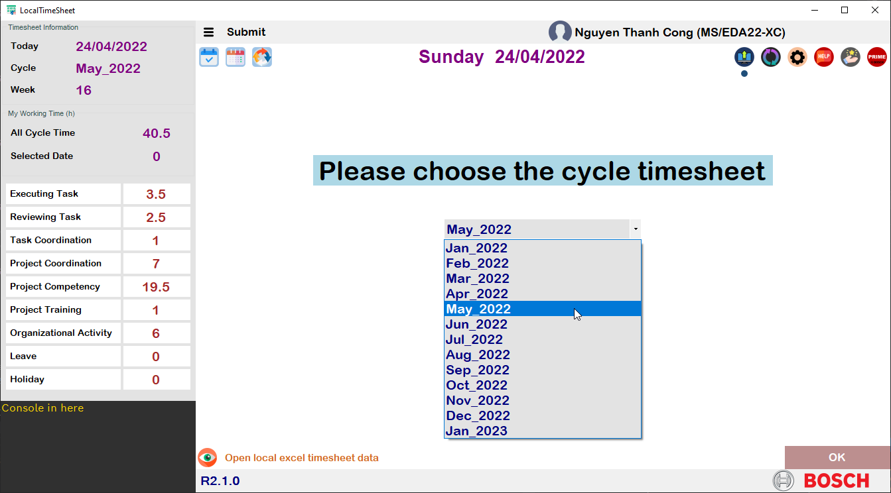
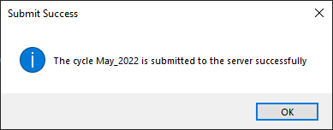
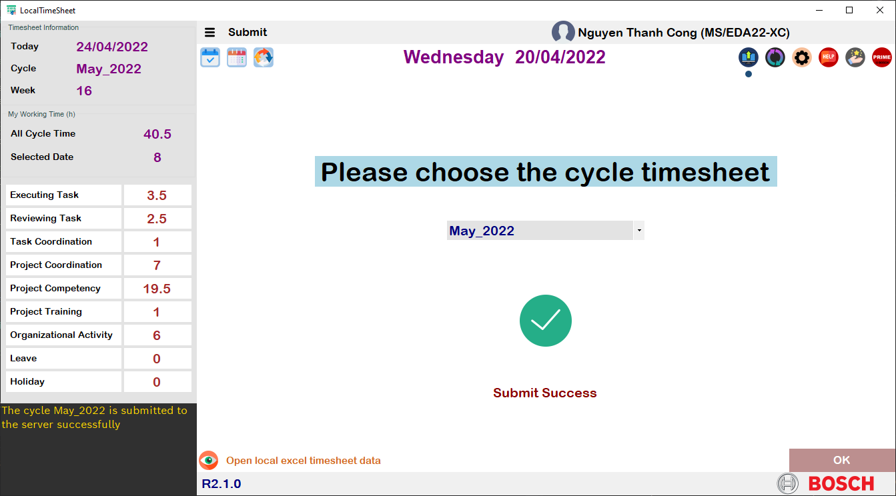
LOCAL TIMESHEET
7. SUBMIT DATA
Open the local excel local timesheet file to check your data by your-self
1
2
3
Submit all data in selected cycle to the server
READ ME

Slide 24
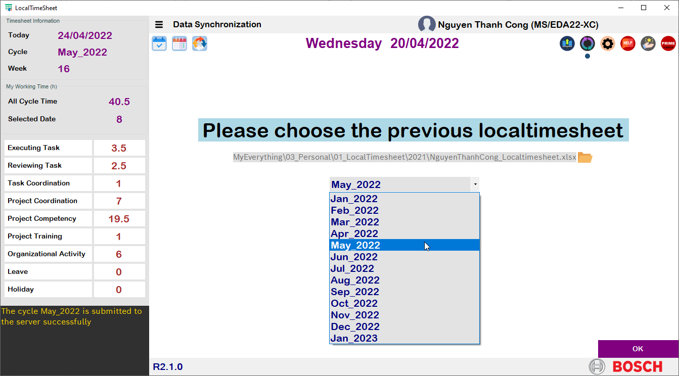
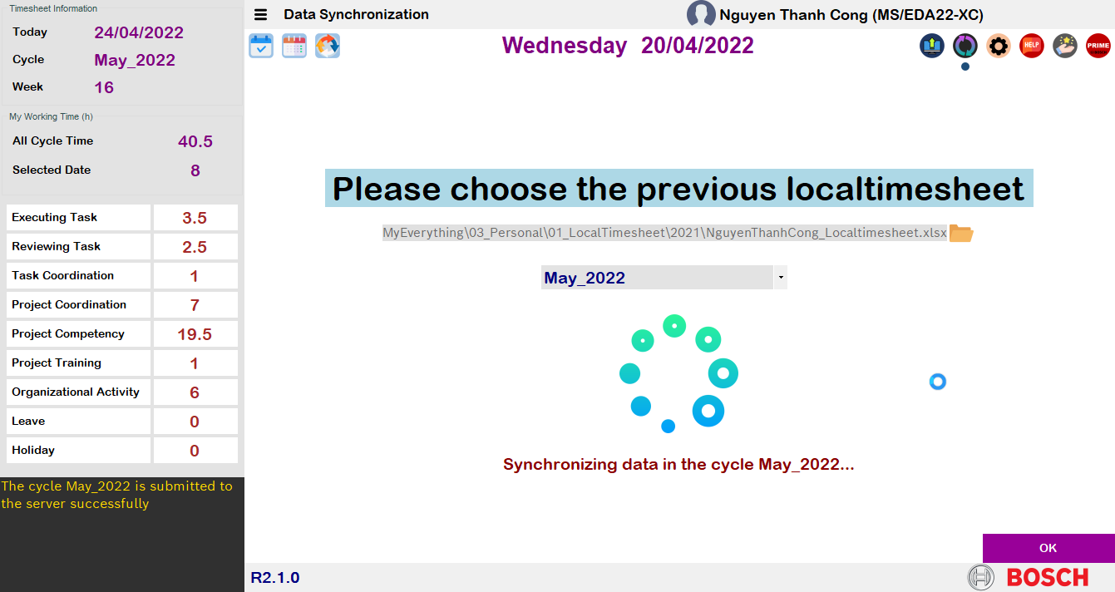
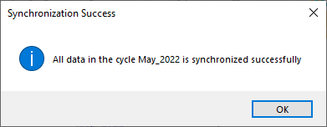
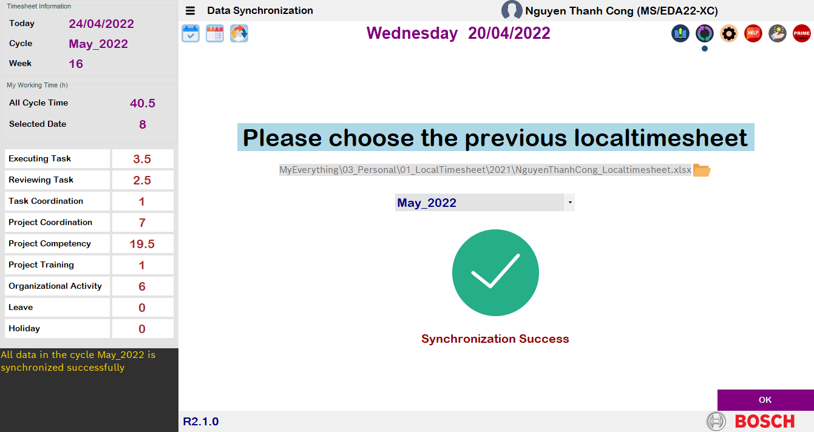
LOCAL TIMESHEET
8. DATA SYNCHRONIZATION
1
2
3
4
The previous excel local timesheet file
READ ME
GOAL OF DATA SYNC
In case your database file ‘dbTimesheet.accdb’ is deleted, you can use the excel localtimesheet file to restore this database

Slide 25
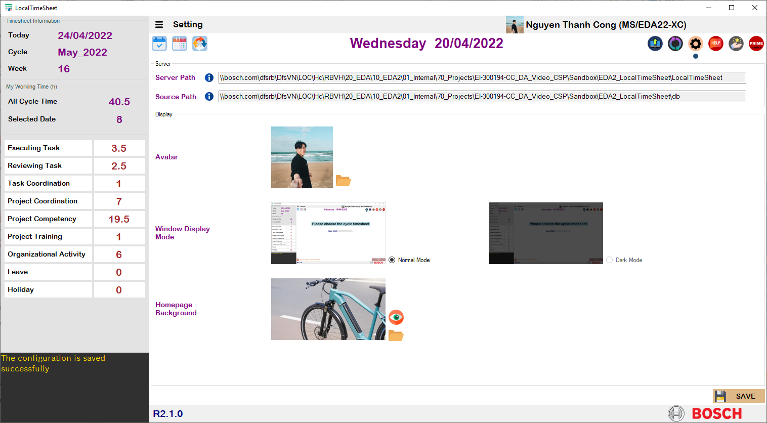
LOCAL TIMESHEET
9. SETTING
Click here to preview the homepage
1
You can change your avatar in here
2
You can change your home page in here
3
4

Slide 26
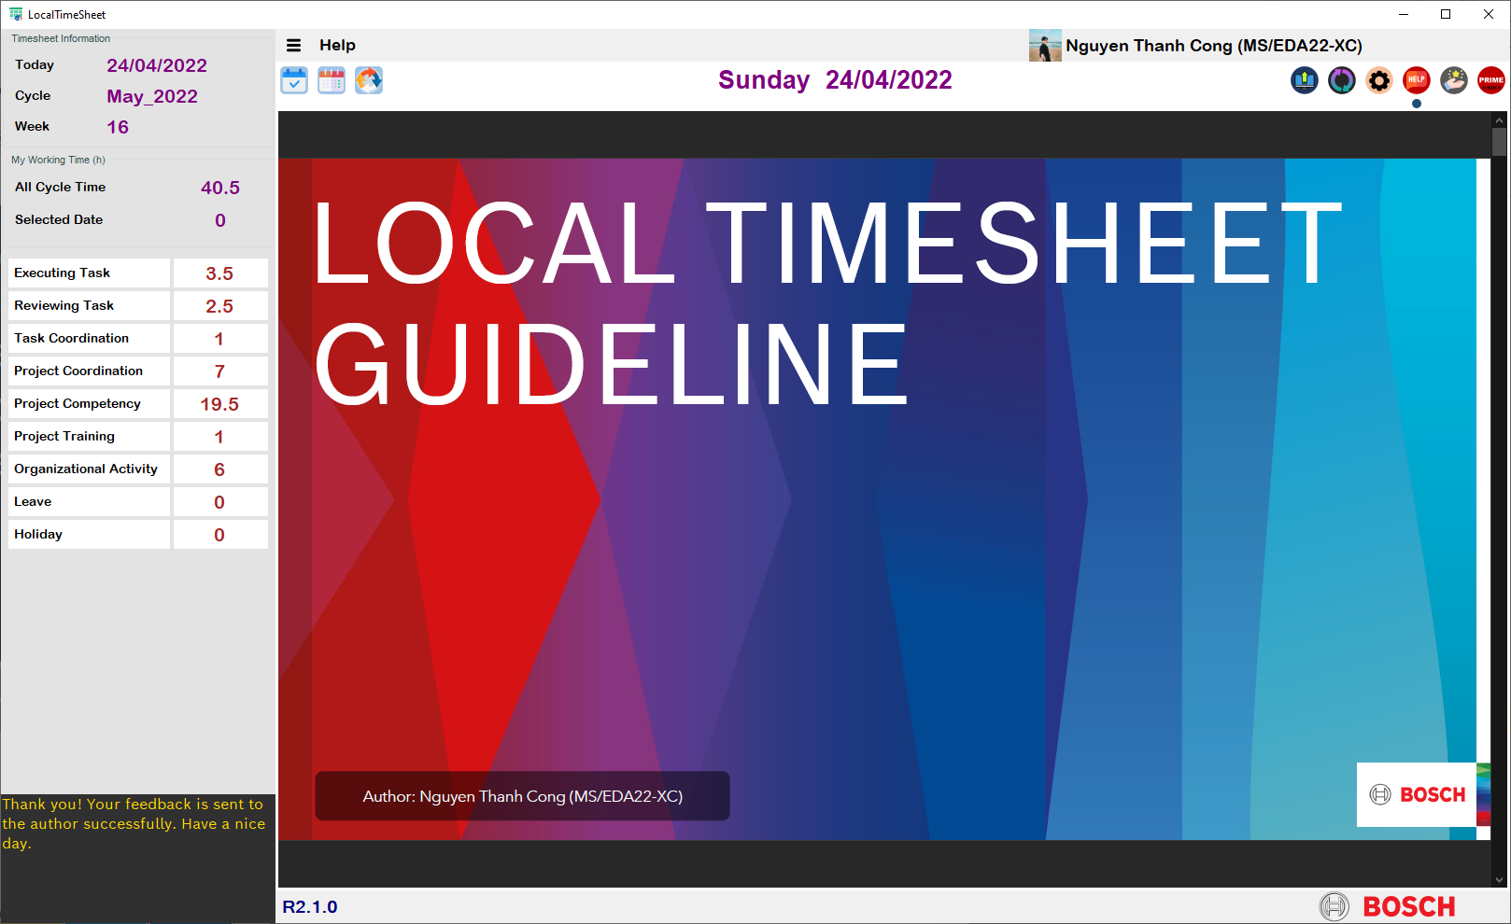
LOCAL TIMESHEET
10. HELP

Slide 27
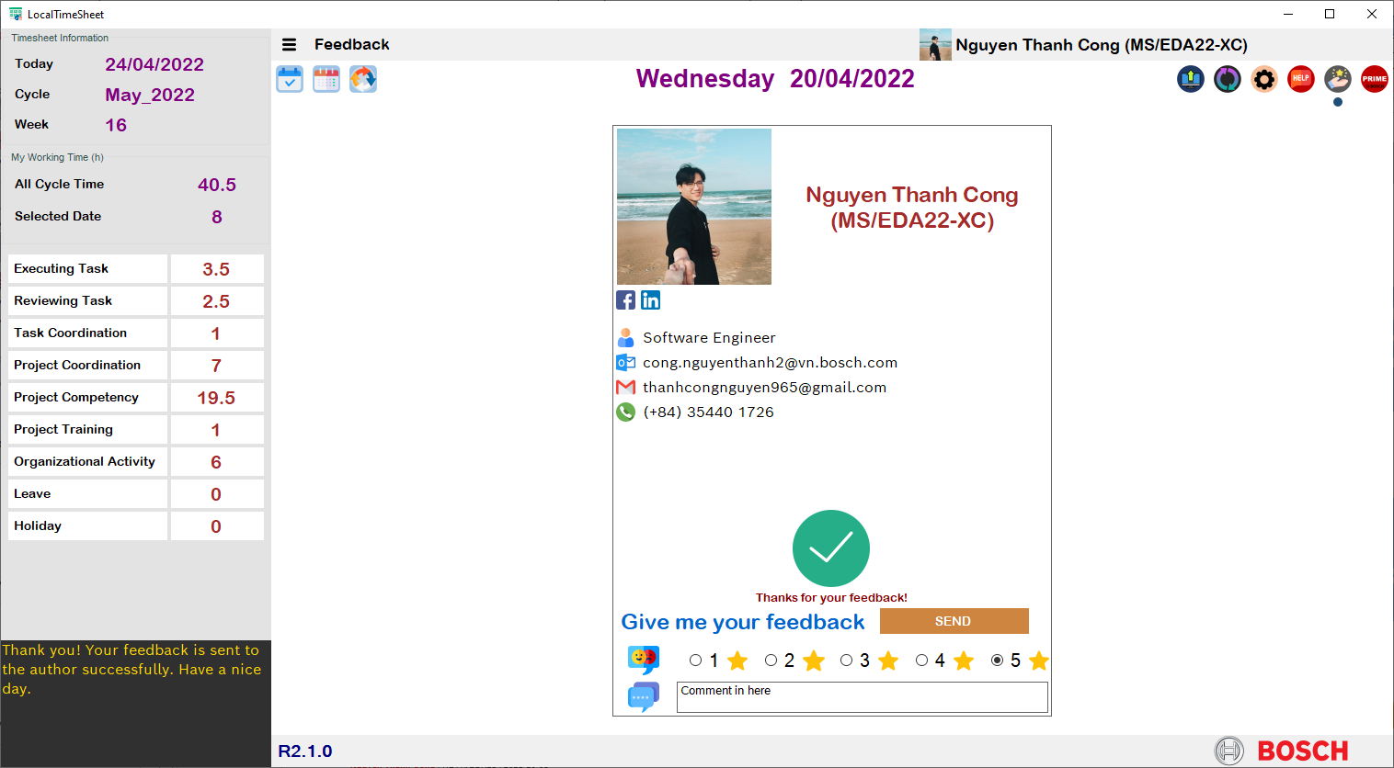
LOCAL TIMESHEET
11. FEEDBACK
1
READ ME
Kindly help feedback for this app if you see any issue, any bug or any inconvenience when you use this app.
If you’d like to propose some improved idea, you can feedback to me.
THANKS SO MUCH!
4
2
3

Slide 28
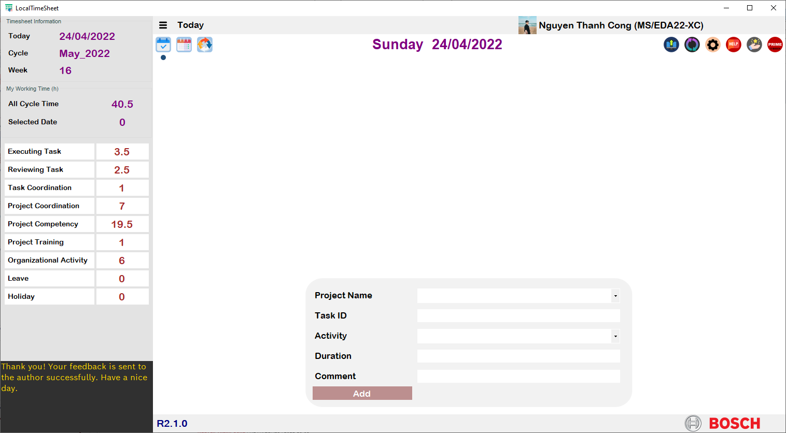
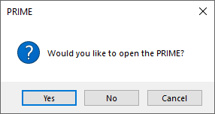
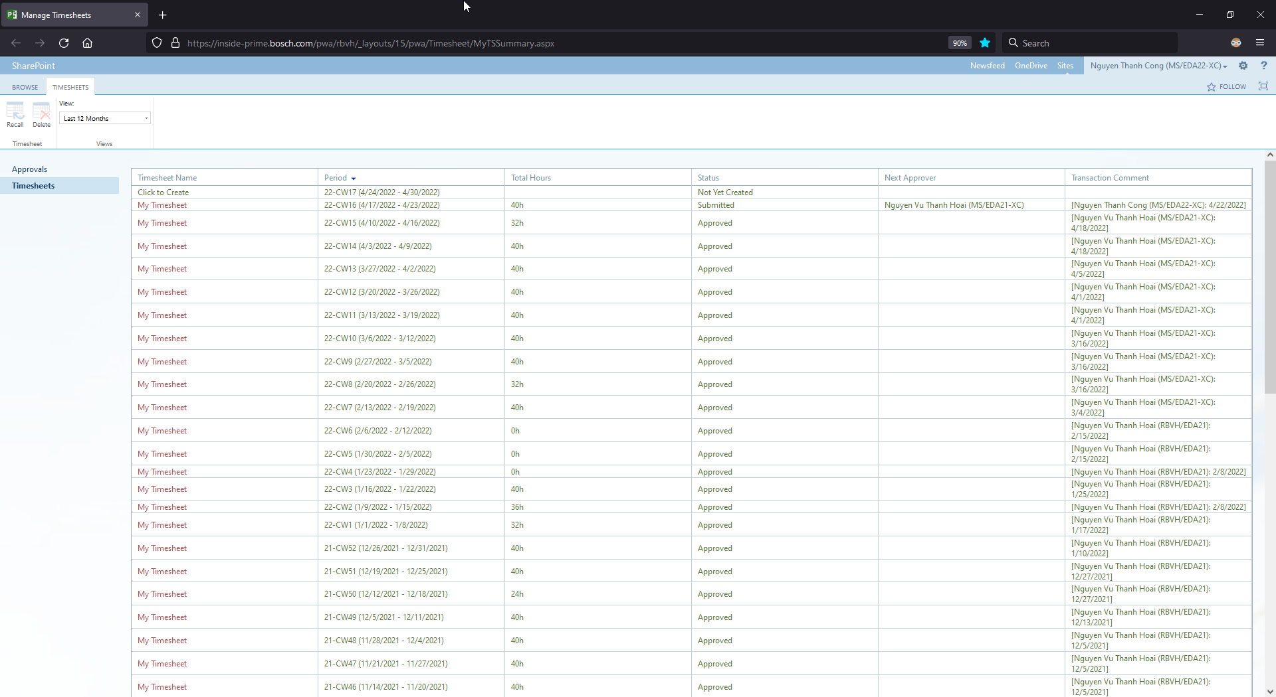
LOCAL TIMESHEET
12. PRIME
PRIME
https://inside-prime.bosch.com/pwa/rbvh/_layouts/15/pwa/Timesheet/MyTSSummary.aspx

